Slide 1
Session outcome
“Describe importance of function and modular programming”

Slide 2
Assessment criteria’s
Assignment
quiz
Mid term examination – II
End term Examination

Slide 3

PROGRAM OUTCOMES MAPPING WITH CO4
[PO.1]. Engineering knowledge: Apply the knowledge of mathematics, science, engineering fundamentals, and an engineering specialization to the solution of complex engineering problems
[PO.2]. Problem analysis: Identify, formulate, research literature, and analyze complex engineering problems reaching substantiated conclusions using first principles of mathematics, natural sciences, and engineering sciences
[PO.3]. Design/development of solutions: Design solutions for complex engineering problems and design system components or processes that meet the specified needs with appropriate consideration for the public health and safety, and the cultural, societal, and environmental considerations
[PO.12]. Life-long learning: Recognize the need for, and have the preparation and ability to engage in independent and life-long learning in the broadest context of technological changes
[PSO 1]. Will be able to design, develop and implement efficient software for a given real life problem

Slide 4
Structured Programming-functions Modular programming and Functions

Slide 5
Programming Scenario . . .
Lengthier programs
Prone to errors
tedious to locate and correct the errors
To overcome this
Programs broken into a number of smaller logical components, each of which serves a specific task.

Slide 6
Modularization
Process of splitting the lengthier and complex programs into a number of smaller units is called Modularization.
Programming with such an approach is called Modular programming
Notes:
Modular programming:
The function main() is a specially recognized function in C. Every program must have a main function to indicate where the program has to begin its execution. It is possible to code any program utilizing only main function, it leads to a number of problems. The program may become too large and complex and as a result the task of debugging, testing and maintaining becomes difficult. If a program is divided into functional parts, then each part may be independently coded and later combined into a single unit. These subprograms called ‘functions’ are much easier to understand, debug, and test. This process is called Modularization or “divide and conquer”. Programming with such an approach is called Modular programming.
There are times when some type of operation or calculation is repeated at many points throughout a program. In such situations, we may repeat the program statements wherever they are needed. There is another way to design a function that can be called and used whenever required. This saves both time and space.

Slide 7
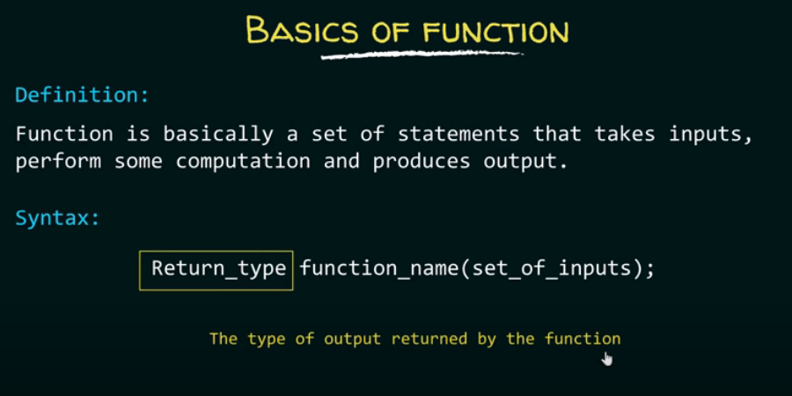

Slide 8
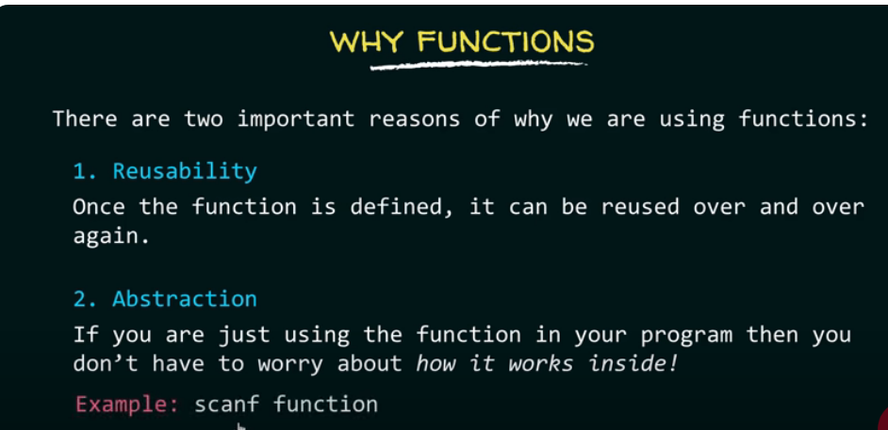

Slide 9
Advantages of modularization
Reusability
Debugging is easier
Build library
Makes programs easier to understand.
Notes:
Modularization clearly results in a number of advantages.
In top-down modular programming, the high level logic of the overall problem is solved first while the details of each lower-level function are addressed later.
The length of a source program can be reduced by using functions at appropriate places.
It is easy to locate and isolate a faulty function for further investigations.
A function may be used by many other programs.

Slide 10
Functions
A function is a set of instructions to carryout a particular task.
Using functions we can structure our programs in a more modular way.
Notes:
Functions
A function is a set of instructions to carryout a particular task.
Using functions we can structure our programs in a more modular way
Basically a function has the following characteristics:
Named with unique name .
Performs a specific task - Task is a discrete job that the program must perform as part of its overall operation, such as sending a line of text to the printer, sorting an array into numerical order, or calculating a cube root, etc.
Independent - A function can perform its task without interference from or interfering with other parts of the program.
May receive values from the calling program (caller) - Calling program can pass values to function for processing whether directly or indirectly (by reference).
May return a value to the calling program – the called function may pass something back to the calling program

Slide 11
Functions
Standard functions
(library functions or built in functions)
User-defined functions
Written by the user(programmer)
Notes:
Functions classified as
Standard functions - library functions or built in functions
User-defined functions - Written by the user(programmer

Slide 12
General form of function definition
return_type function_name(parameter_definition)
{
variable declaration;
statement1;
statement2;
.
.
.
return(value_computed);
}
Notes:
The general form of a function definition
return_type function_name(parameter_definition)
{
variable declaration; // local variables
executable statement1;
executable statement2;
.
.
return(expression);
}
All parts are not essential. Some may be absent. For example, the argument list and its associated argument declaration parts are optional. The declaration of local variables is required only when any local variables are used in the function. A function can have any number of executable statements. A function that does nothing, may not include any executable statements at all.
Do_nothing() {}
The return statement is the mechanism for returning a value to the calling function. This is also optional statement. Its absence indicates that no value is being returned to the calling function.
Function return type - Specifies the data type that the function should returns to the caller program. Can be any of C data types: char, float, int, long, double, pointers etc. If there is no return value, specify a return type of void.
Function name - Can have any name as long as the rules for C / C++ variable names are followed and must be unique.
Parameter list - Many functions use arguments, the value passed to the function when it is called. A function needs to know the data type of each argument. Argument type is provided in the function header by the parameter list. Parameter list acts as a placeholder.
For each argument that is passed to the function, the parameter list must contain one entry, which specifies the type and the name.
For example,
void myfunction(int x, float y, char z)
void yourfunction(float myfloat, char mychar)
int ourfunction(long size)
The first line specifies a function with three arguments: type int named x, type float named y and type char named z.
Some functions take no arguments, so the parameter list should be void or empty such as,
long thefunction(void)
void testfunct(void)
int zerofunct()

Slide 13
Defining a Function
Name (function name)
You should give functions descriptive names
Same rules as variable names, generally
Return type
Data type of the value returned to the part of the program that activated (called) the function.
Parameter list (parameter_definition)
A list of variables that hold the values being passed to the function
Body
Statements enclosed in curly braces that perform the function’s operations(tasks)
Notes:
Defining a Function
Name:
You should give functions descriptive names
Same rules as variable names, generally
Return type
Data type of the value returned to the part of the program that activated(called) the function
Parameter list
A list of variables that hold the values being passed to the function
Body
Statements enclosed in curly braces that perform the function’s operations(tasks)

Slide 14
#include<stdio.h>
#include<conio.h>
void calculateSquare(int number)
{
int square=number*number;
printf("Square of %d is%d\n",number,square);
}
int main()
{
calculateSquare(5);
calculateSquare(25);
return 0;
}

Slide 15
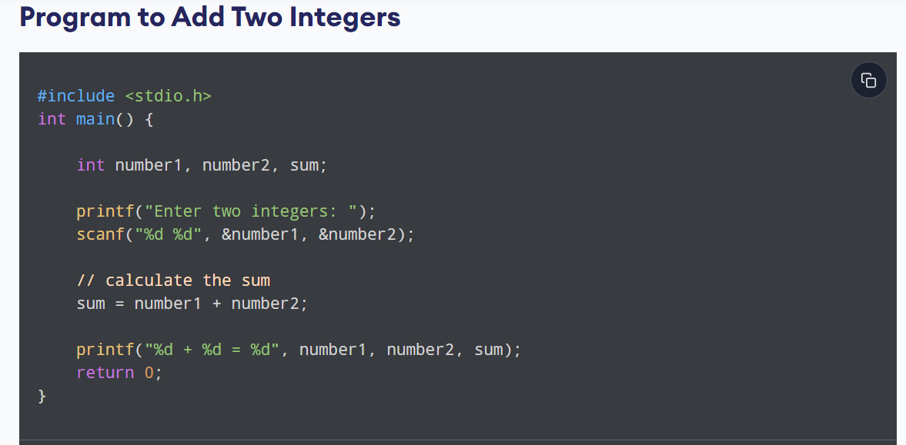
* 10 times you want to run

Slide 16
#include <stdio.h>
Void sum() // function definition
{ int number1, number2, sum;
printf("Enter two integers: ");
scanf("%d %d", &number1, &number2);
// calculate the sum
sum = number1 + number2;
printf("%d + %d = %d", number1, number2, sum);}
Void main()
{
Sum(); // calling
}

Slide 17
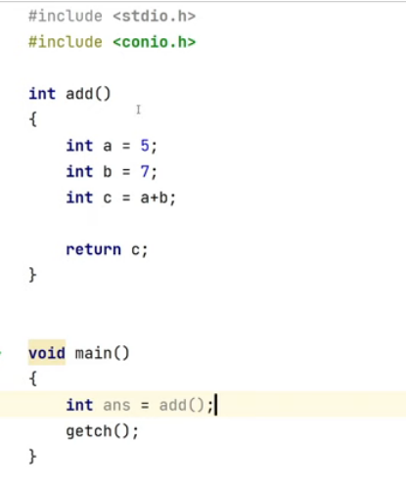

Slide 18
Understanding of main function
Return type
Function name
Parameter List
int main (void)
{
printf(“hello world\n”);
return 0;
}
}
Body
Notes:
______________Example 1______________
void main (void)
{
cout << “hello world\n”; }
_______________________________________

Slide 19
Function Definition and Call
// FUNCTION DEFINITION
Return type
Function name
Parameter List
void DisplayMessage(void)
{
printf(“Hello from function DisplayMessage\n”);
}
int main()
{
printf(“Hello from main \n”);
DisplayMessage(); // FUNCTION CALL
printf(“Back in function main again.\n”);
return 0;
}

Slide 20
Multiple Functions- An example
void First (void){
printf(“I am now inside function First\n”);
}
void Second (void){
printf( “I am now inside function Second\n”);
First();
printf(“Back to Second\n”);
}
int main (){
printf( “I am starting in function main\n”);
First ();
printf( “Back to main function \n”);
Second ();
printf( “Back to main function \n”);
return 0;
}
// FUNCTION DEFINITION
// FUNCTION DEFINITION
// FUNCTION CALL
// FUNCTION CALL
// FUNCTION CALL
Notes:
___________Example 3____________________________
void First (void) // MULTIPLE FUNCTIONS
{ cout << “I am now inside function First\n”;}
void Second (void)
{ cout << “I am now inside function Second\n”;
}
void main ()
{ cout << “I am starting in function main\n”;
First (); //CALL TO First
Second (); // CALL TO Second
cout << “Back in function main again.\n”;
}
________________________________________________

Slide 21
Arguments and parameters
Both arguments and parameters are variables used in a program & function.
Variables used in the function reference or function call are called as arguments. These are written within the parenthesis followed by the name of the function. They are also called actual parameters.
Variables used in function definition are called parameters, They are also referred to as formal parameters.
Notes:
Arguments and parameters
Both arguments and parameters are variables used in a program and function.
Variables used in the function reference or function call are called as arguments. These are written within the parenthesis followed by the name of the function. They are also called actual parameters
Variables used in function definition are called parameters, They are also referred to as formal parameters

Slide 22
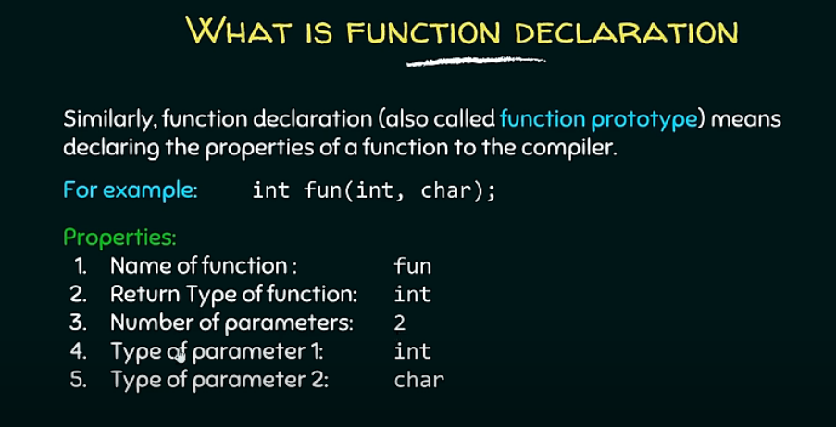

Slide 23
Functions
Formal parameters
void dispChar(int n, char c) {
printf(" You have entered %d & %c“,n,c);
}
int main(){ //calling program
int no; char ch;
printf(“Enter a number & a character: \n“);
scanf(“%d %c”,&no,&ch);
dispChar( no, ch); //Function reference
return 0;
}
Actual parameters

Slide 24
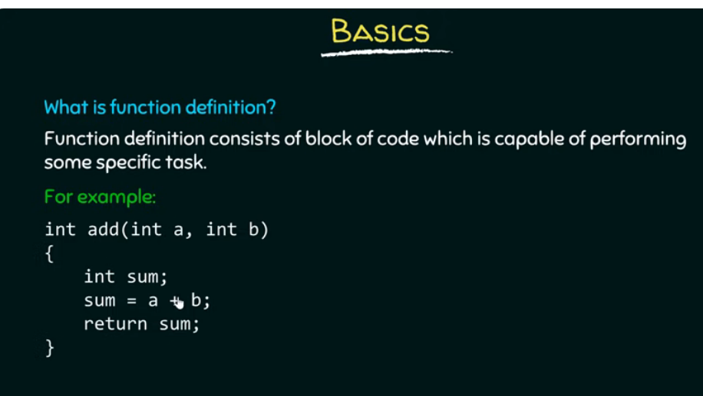

Slide 25
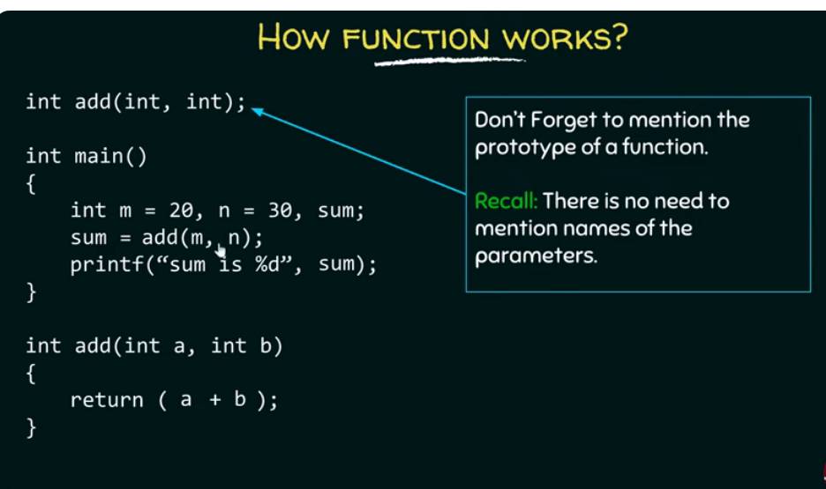

Slide 26
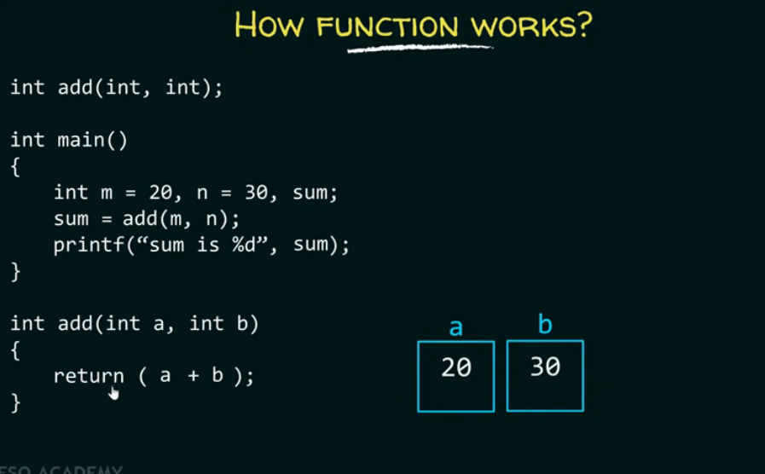



Slide 27
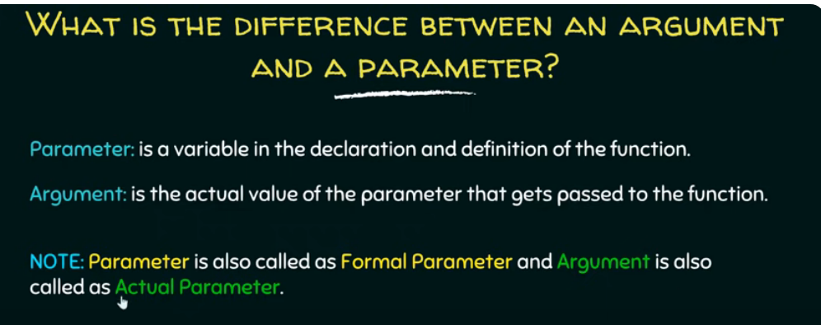

Slide 28
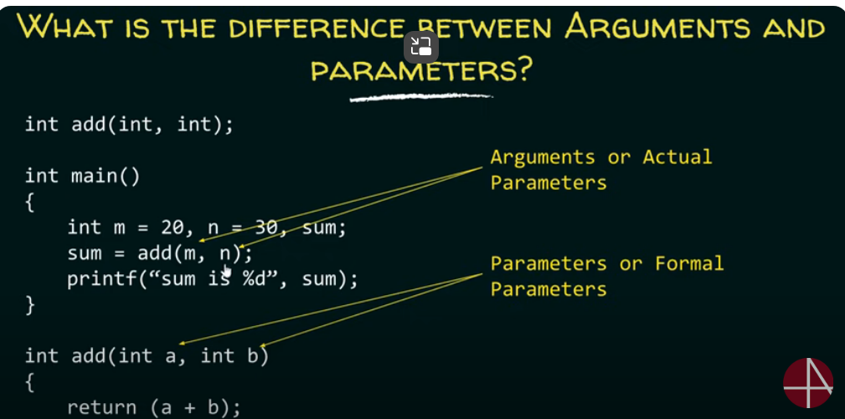

Slide 29
Function Prototypes
Must be included for each function that will be defined, (required by Standards for C++ but optional for C) if not directly defined before main().
In most cases it is recommended to include a function prototype in your C program to avoid ambiguity.
Identical to the function header, with semicolon (;) added at the end.
Function prototype (declaration) includes
Function name
Parameters – what the function takes in and their type
Return type – data type function returns (default int)
Parameter names are Optional.
Notes:
Must be included for each function that will be defined, (required by Standards for C++ but optional for C) if not directly defined before main().
In most cases it is recommended to include a function prototype in your C program to avoid ambiguity.
Identical to the function header, with semicolon (;) added at the end.
Function prototype includes information about the function’s return type, name and parameters’ list and type.
The general form of the function prototype is shown below,
function_return_type function_name(type parameter1, type parameter2,…, type parameterN)
An example of function prototype,
long cube(long);

Slide 30
Function Prototypes
Function prototype provides the compiler the name and arguments of the functions and must appear before the function is used or defined.
It is a model for a function that will appear later, somewhere in the program.
General form of the function prototype:
fn_return_type fn_name(type par1, type par2, …, type parN);
Example:
int maximum( int, int, int );
Takes in 3 ints
Returns an int
Notes:
Function prototype provides the C compiler the name and arguments of the functions and must appear before the function is used or defined.
It is a model for a function that will appear later, somewhere in the program.
From the previous prototype example, 'we' know the function is named cube, it requires a variable of the type long, and it will return a value of type long.
Then, the compiler can check every time the source code calls the function, verify that the correct number and type of arguments are being passed to the function and check that the return value is returned correctly.
If mismatch occurs, the compiler generates an error message enabling programmers to trap errors.
A function prototype need not exactly match the function header.
The optional parameter names can be different, as long as they are the same data type, number and in the same order.
But, having the name identical for prototype and the function header makes source code easier to understand.

Slide 31
Scope of Variables
A scope is a region of the program where a defined variable can have its existence and beyond that variable it cannot be accessed.
There are two types of variables in C
1) local variables
2) global variables

Slide 32
Local Variables
Variables that are declared inside a function are called local variables.
They can be used only by statements that are inside that function.
In the following example all the variables a, b, and c are local to main() function.
#include <stdio.h>
int main () {
/* local variable declaration */
int a, b, c;
a = 10; b = 20; c = a + b;
printf ("value of a = %d, b = %d and c = %d\n", a, b, c);
return 0;
}

Slide 33
Global Variables
Global variables are defined outside a function, usually on top of the program.
Global variables hold their values throughout the lifetime of your program and they can be accessed inside any of the functions defined for the program.
#include <stdio.h>
int g; /* global variable declaration */
int main () {
int a, b; /* local variable declaration */
a = 10; b = 20; g = a + b;
printf ("value of a = %d, b = %d and g = %d\n", a, b, g);
return 0;
}

Slide 34
Functions- points to note
The parameter list must be separated by commas.
dispChar( int n, char c);
The parameter names do not need to be the same in the prototype declaration and the function definition.
The types must match the types of parameters in the function definition, in number and order.
void dispChar(int n, char c); //proto-type
void dispChar(int num, char ch){
printf(" You have entered %d &%c”, num,ch);
}
Use of parameter names in the declaration(prototype) is optional but parameter type is a must.
void dispChar(int , char); //proto-type

Slide 35
Functions- points to note
If the function has no formal parameters, the list can be written as (void) or simply ()
The return type is optional, when the function returns integer type data.
The return type must be void if no value is returned.
When the declared types do not match with the types in the function definition, compiler will produce error.

Slide 36
Functions- Categories
Categorization based on the arguments and return values
Functions with no arguments and no return values.
Functions with arguments and no return values.
Functions with arguments and one return value.
Functions with no arguments but return a value.
Functions that return multiple values
(will see later with parameter passing techniques).

Slide 37
Function with No Arguments/parameters & No return values
dispPattern(); // prototype
int main(){
printf(“fn to display a line of stars\n”);
dispPattern();
return 0;
}
dispPattern(){
int i;
for (i=1;i<=20 ; i++)
printf( “*”);
}
Notes:
No arguments and no return values:
When a function has no arguments, it does not receive any data from the calling function. Similarly, when it does not return a value, the calling function does not receive any data from the called function. In effect, there is not data transfer between the calling function and the called function. The dotted lines indicate that there is only a transfer of control but not data.
Function1() No input function2()
--------------→
{ {
----------------
function2() No return value --------------
---------------- ←----------- --------------
---------------- --------------
} }
A program with three user-defined functions is given below.
Functions with no arguments, no return values:
main()
{
printtext();
value();
printtext();
}
printtext()
{
int I;
for (i=1;i<=40;i++)
cout << ‘-‘<<“\n”;
}
value()
{
int year, period;
float inrate, sum principal;
cout <<“Principal amount?”;
cin>>principal;
cout<<“Interest rate? “;
cin>>inrate;
cout<<“Period? “;
cin>>period;
sum=principal;
year=1;
while(year<=period)
{
sum=sum * (1+inrate);
year=year+1;
}
cout<<”\n”<< principal<<inrate<<period<<sum;
}

Slide 38
Function with No Arguments but A return value
int readNum(void); // prototype
int main(){
int c;
printf(“Enter a number \n”);
c=readNum();
printf(“The number read is %d“,c);
return 0;
}
int readNum(){
int z;
scanf(“%d”,&z);
return(z);
}

Slide 39
Fn with Arguments/parameters & No return values
void dispPattern(char ch); // prototype
int main(){
printf(“fn to display a line of patterns\n”);
dispPattern(‘#’);
dispPattern(‘*’);
dispPattern(‘@’);
return 0;
}
void dispPattern(char ch ){
int i;
for (i=1;i<=20 ; i++)
printf(“%c”,ch);
}
Notes:
Functions with arguments and no return values:
We can make the calling function to read data from the terminal and pass it on to the
called function. The nature of data communication between the calling function and
the called function with arguments but no return values is shown below.
Function1() function2(1)
{ values of arguments ---------------
-------------- ------------→ {
function2(a) --------------
-------------- < ----------- ---------------
------------- ---------------
} }
For example.
Printtext(ch)
Value(p,r,n)
The arguments ch,p,r and n are called the formal arguments. The calling function can now send values to these arguments using function calls containing appropriate arguments. For example, the function call
Value(100,0.23,10)
Would send the values 100,0.23,and 10 to the function.
Value(p,r,n)
And assign 100 to p, 0.23 ,to r, and 10 n. The values 100,0.23 and 10 are the actual arguments which become the values of the formal arguments inside the called function.
The actual and formal functions should match in number, type and order. The values of actual arguments are assigned to the formal arguments on a one to one basis starting with the first argument.
main()
{
Function
call --------------
-----→ function1(a1,a2,a3………am)
-------------
}
Called function
------ > function1(f1,f2,f3,………….fn)
--------------
--------------
{
----------
----------
}
The formal arguments must be valid variable names, the actual arguments may be variable names, expressions or constants. The variables used in actual arguments must be assigned values before the function call is made.
When a function call is made, only a copy of the values of actual arguments is passed into the called function.
The function call value(prin, rate, per);
Passes information it contains to the function value.
The function header of value has three formal arguments p,r and n which correspond to the actual arguments in the function call, namely, prin,rate and per. The formal arguments are declared immediately after the function header. On execution of the function call, the values of the actual arguments are assigned to the corresponding formal arguments.
p=prin;
r=rate;
n=per;
The variable declared inside a function are known as local variables and therefore their values are local to the function and cannot be accessed by any other function.
The function value calculates the final amount for a given period and prints the result. Control is transferred back on reaching the closing brace of the function. Note that the function does not return any value.
Program to show functions with arguments but no return values
Main()
{
float prin.rate,amt;
int per;
cout<<“Enter principal amount, interest”;
cout<<”rate and period\n”;
cin>>prin>>rate>>per;
printtext(‘Z’);
value(prin,rate,per);
printtext(‘A’);
}
printtext(ch)
char ch;
{
int j;
for(j=1;j<=52;j++)
cout<< ch;
cout<<“\n”;
}
value(p,r,n)
int n;
float p,r;
{
int year;
float sum;
sum=p;
year=1;
while(year<=n)
{
sum=sum*(1+r)
year=year+1;
}
cout<<” \n”<< p<< r<< n<< sum;
}

Slide 40
Function with Arguments/parameters & One return value
int fnAdd(int,int);
int main(){
int a,b,c;
printf(“\nEnter numbers to be added\n”);
scanf(“%d %d”,&a,&b);
c=fnAdd(a,b);
printf(“Sum is %d “, c);
return 0;
}
int fnAdd(int x, int y ){
int z;
z=x+y
return(z);
}

Slide 41
Extra Problems…
Write appropriate functions to
Find the factorial of a number ‘n’.
Reverse a number ‘n’.
Check whether the number ‘n’ is a palindrome.
Generate the Fibonacci series for given limit ‘n’.
Check whether the number ‘n’ is prime.
Generate the prime series using the function written for prime check, for a given limit.

Slide 42
Factorial of a given number ‘n’
long factFn(int); //prototype
int main() {
int n, f;
printf("Enter a number :“);
scanf(“%d”,&n);
f =factFn(n);
printf(“Fact= %d“,f);
return 0;
}
long factFn(int num) {
//function definition
int i;
long fact=1;
//factorial computation
for (i=1; i<=num; i++)
fact=fact * i;
// return the result
return (fact);
}

Slide 43
Reversing a given number ‘n’
int Reverse(int); //prototype
int main()
{
int n,r;
printf("Enter a number : \n“);
scanf(“%d”, &n);
r= Reverse(n);
printf(“ reversed no=%d“,r)
return 0;
}
int Reverse(int num)
{
int rev=0;
int digit;
while(num!=0)
{
digit = num % 10;
rev = (10 * rev) + digit;
num = num/10;
}
return (rev);
}

Slide 44
Check whether given number is prime or not
int IsPrime(int); //prototype
int main() {
int n;
printf(“Enter a number : “);
scanf(“%d”,&n);
if (IsPrime(n))
Printf(“%d is a prime no”,n);
else
Printf(“%d is not a prime no”,n);
return 0;
}
int IsPrime(int num) //prime check
{
int p=1;
for(int j=2;j<=num/2;j++)
{
if(num%j==0)
{
p=0;
break;
}
}
return p;
}
Notes:
Program to check whether given number is prime or not using function IsPrime. The function returns 1 if the given number is Prime otherwise returns 0.

Slide 45
First n Fibonacci number generation
void fibFn(int); //prototype
int main() {
int n;
printf("Enter the limit ”);
scanf(“%d”,&n);
fibFn(n); //function call
return 0;
}
void fibFn(int lim) { //fib generation
int i, first, sec, next;
if (lim<=0)
printf("limit should be +ve.\n“);
else
{
printf("\nFibonacci nos\n“);
first = 0, sec = 1;
for (i=1; i<=lim; i++) {
printf(“%d”, first)
next = first + sec;
first = sec;
sec = next;
}
}
}

